Slide 1

E-Commerce
Name: Mahammadtaaha C. Daruwala
Enrl.No.:160410116023
ID No.:16BEITG057
Subject: Engineering Economics & Management
SY I.T.-1 Batch-B

Slide 2
What is Commerce?
According to Dictionary.com
Commerce is a division of trade or production which deals with the Exchange of goods and services from producer to final consumer.
It comprises the trading of something of economics value such as
Goods,services,information or money between two or more entities.

Slide 3
What is E-Commerce?
Commonly known as ‘Electronic Marketing.’
“It consists of buying and selling goods and services over
An electronic systems such as the internet and other computer networks.”
“E-commerce is the purchasing, selling and exchanging
goods and services over the internet through which tran-
saction or term of sale are performed electrically”

Slide 4
Traditional Bussiness
Manf.unit
Distributor
Wholrsaler
Retailer
Customer
Advertisement
Direct Selling
Company
Customer

Slide 5
Why we use E-Commerce?
Exploitation of new business
Improvement of business transaction
Greater economic efficiency
Increasing of revenue
Low entry cost
Reduces transaction cost
Access to global market
Secure market share

Slide 6
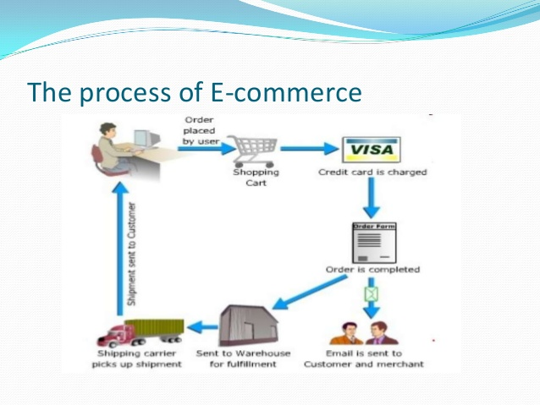

Slide 7
A customer uses Web browser to connect to the home page
of a merchant’s Web site on the internet.
The consumer browses the catalog of products featured
on the site and selects items to purchase.The selected items
are placed in in the electronic equivalent of a shopping cart.
When the consumer is ready to complete the purchase of
selected items,he provides a bill-to and ship-to address for
purchase and delivery.
When the credit card number is validated and the order is
completed at the Commerce Server site,the merchant’s site displays a receipt confirming the customer’s purchase.
The commerce service site then forwards the order to a
Processing network for payment processing and fulfilment.

Slide 8
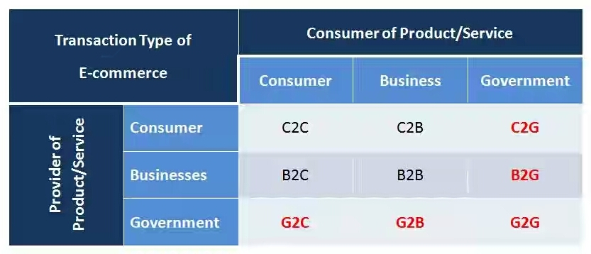
Types of E-Commerce

Slide 9
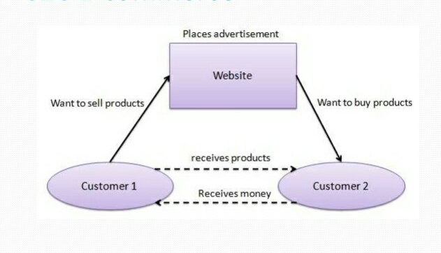
C2C(Customer to Customer) E-commerce
It is a simply commerce between private individuals or
consumers.
Customers interact through shopping websites.
Example:
One person buying a car from another person through OLX.
My neighbour selling mobile to me.

Slide 10
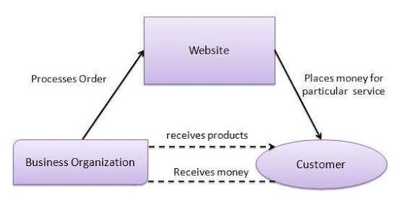
C2B(Customer to Business)
It is the most recent E-Commerce business model,in which
individual customers offer to sell products and services to
companies which are prepared to purchase them.

Slide 11
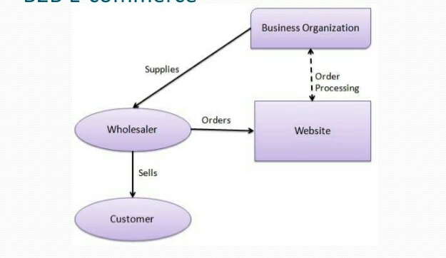
B2B(Business to Business)
It is simply defined as E-commerce between companies.
About 80% of e-commerce is of this type.
Example:
Intel selling microprocessor to Dell.

Slide 12
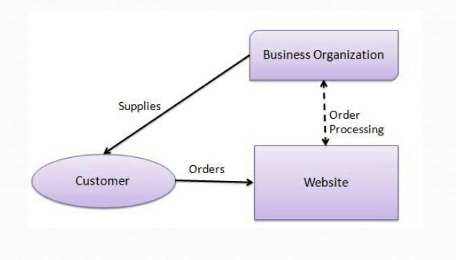
B2C(Business to Customer)
It is the E-commerce between companies and customers.
It involves customers gathering information;purchasing physical goods or receiving products over an electronic
network.
Example:
Honda selling me a activa.

Slide 13
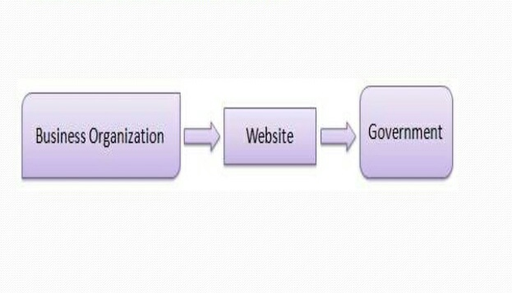
B2G(Business to Government)
It is generally defined as commerce between companies
and public sector.It refers to the use of internet for public procurement,licensing procedures and other government
related operations.
Example:
Sell goods and services to Government agencies.
Business taxes.

Slide 14
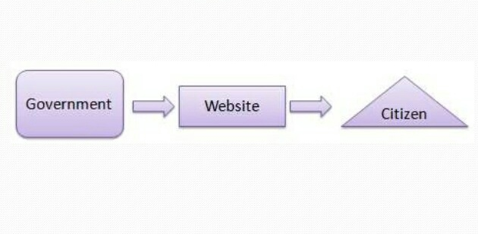
G2C(Government to Customer)
It is the a part of e-governance.
The objective of this model is to provide goods and services to
each citizen.
The Government provides following facilities through website.
Information of all government departments,
Different welfare schemes,
Application forms to be used by the citizens.

Slide 15
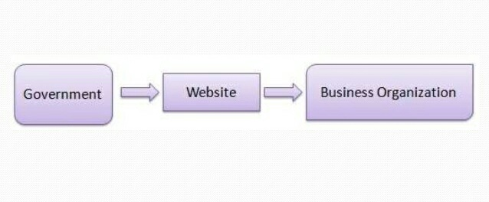
G2B(Government to Business)
It refers to gevernment providing services or information
to business organization.

Slide 16
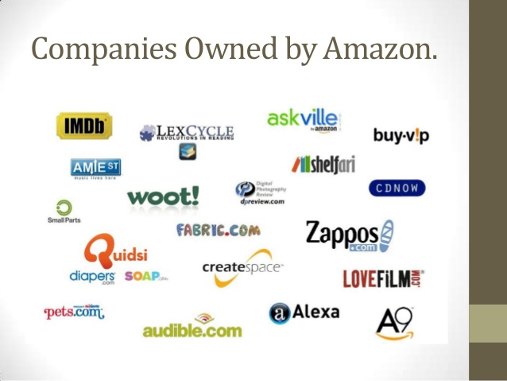
Case Study :- About AMAZON
Amazon is an American International e-commerce company.
It was started by Jeffory P.Bexos in 1994.
It is a world’s largest online retailer.
When many companies were not able to survive during the 90’s,Amazon managed to survive and is successful now.
It is the 11th most searched site around the world.
The structure of website will definitely make you to buy.

Slide 17
Case 1:
Why amazon.com succeeded online when so many companies
Have failed???
Amazon always welcomed addition of new products to its site.Even though it has started its business selling books.
Presently it deals with 21 categories of products.
If any individual wants anything,the first vender comes to people’s mind is Amazon.
It is easy to sell your product with the help of amazon.So this
attracted many suppliers.
You can’t get things at a cheaper price anywhere than amazon.

Slide 18
Case 2:
Will the KINDLE revolutionize the book industry???
With the enormous development of technolgy,people get updated with their electronic machines.
Kindle offers you a easy to carry option.
You can carry many books in a slim tab.
Reading at night time without a light is possible.
Many sites offer free kindle books.
Therefore in future kindle users will increase.

Slide 19


Slide 20
THANK YOU!

